Slide 1

How to analysis qPCR Data
Prashant
Research Method Tutorial 5

Slide 2
Is qPCR, RT PCR and RT-qPCR Same?
NO
Minimum Information for Publication of Quantitative Real-Time PCR Experiments (MIQE) guidelines

Slide 3
Is qPCR, RT PCR and RT-qPCR Same?
To prevent confusion, the Minimum Information for Publication of Quantitative Real-Time PCR Experiments (MIQE) guidelines, first published in 2009, proposed a standardization of abbreviations.
‘RT-PCR’ should only be used to describe reverse transcription PCR and not real-time PCR, as is often confused.
According to MIQE, the acronym ‘qPCR’ describes quantitative real-time PCR
And the final acronym ‘RT-qPCR’ is used for reverse transcription quantitative real-time PCR.
A beginner’s guide to RT-PCR, qPCR and RT-qPCR | The Biochemist | Portland Press

Slide 4
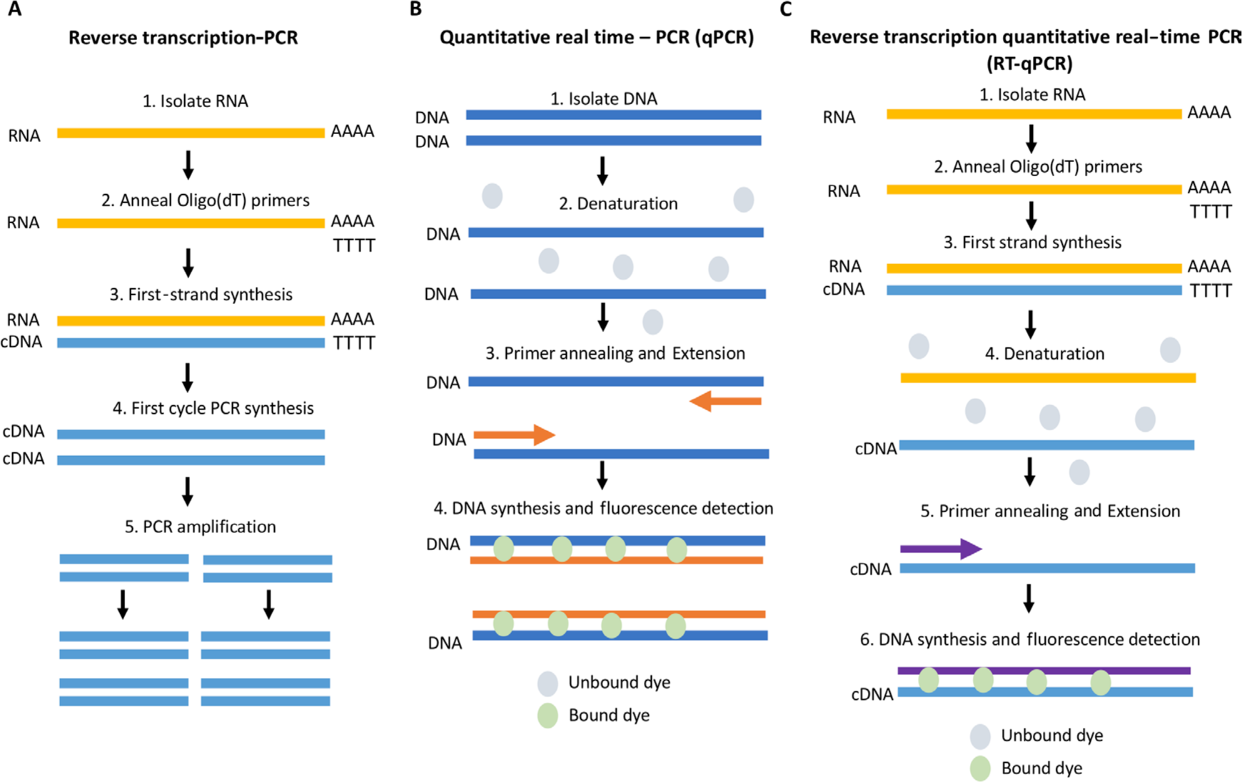
Is qPCR, RT PCR and RT-qPCR Same?
Schematic comparing RT-PCR, qPCR and RT-qPCR. (A) RT-PCR workflow. RNA is isolated and cDNA is generated via reverse transcription (RT); PCR is then carried out to amplify areas of interest. (B) qPCR schematic. DNA is isolated and amplified; amplification is quantitated using a probe which fluoresces upon intercalation with double-stranded DNA. (C) RT-qPCR procedure. RNA is isolated and cDNA generated before commencing a qPCR procedure.

Slide 5
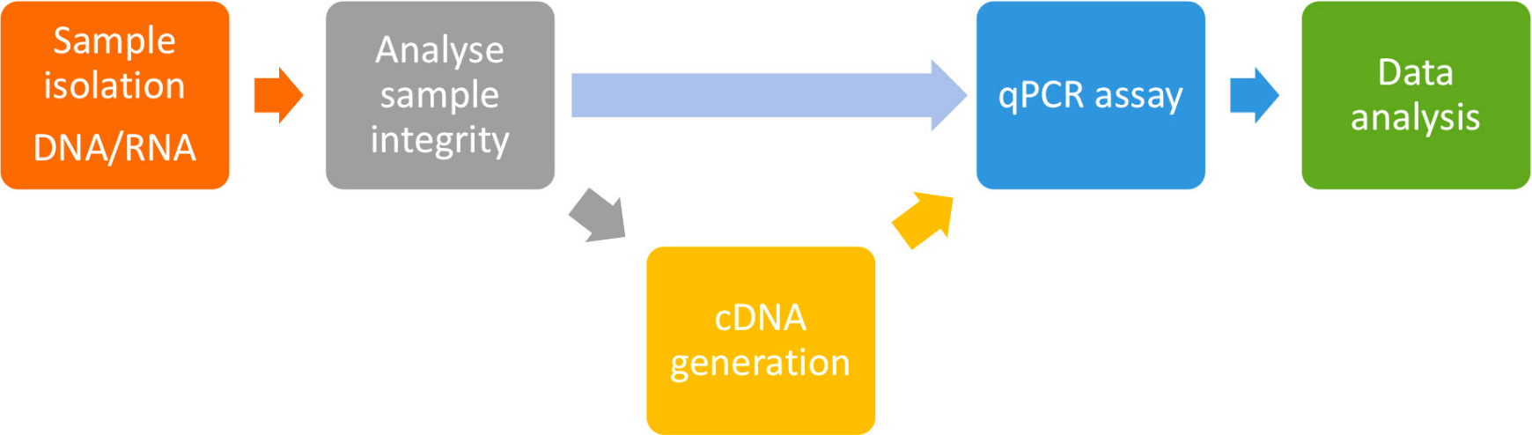
Working with qPCR
Workflow of a standard qPCR and RT-qPCR experiment.

Slide 6
Workflow of a standard qPCR and RT-qPCR experiment.

Slide 7
What do we get in the form of data from qPCR?
Ct (Cycle Threshold) Values:
The Ct value is the number of cycles required for the fluorescent signal to exceed the background level. It is inversely proportional to the amount of target nucleic acid in the sample; lower Ct values indicate higher amounts of target nucleic acid.
ΔCt (Delta Ct) Values:
ΔCt is the difference between the Ct value of the target gene and the Ct value of a reference gene (housekeeping gene). This normalization accounts for variations in the amount of starting material and efficiency of the PCR reaction.
ΔΔCt (Delta Delta Ct) Values:
ΔΔCt is the difference between the ΔCt of the experimental sample and the ΔCt of the control sample. This comparative method allows for the calculation of relative gene expression levels.
Quantification (Absolute or Relative):
Absolute Quantification: Provides the exact number of copies of the target nucleic acid in the sample by comparing Ct values to a standard curve generated from known concentrations of target.
Relative Quantification: Measures changes in gene expression levels relative to a control sample, usually using the ΔΔCt method.

Slide 8
What do we get in the form of data from qPCR?
Melting Curve Analysis:
Melting curves provide information on the specificity of the qPCR by measuring the dissociation characteristics of the double-stranded DNA product. This helps identify non-specific products and primer-dimers.
Amplification Efficiency:
The efficiency of the PCR reaction, which ideally should be between 90-110%. It is calculated from the slope of the standard curve.
Standard Curves:
Generated by plotting Ct values against the logarithm of known concentrations of the target nucleic acid. Used in absolute quantification to determine the concentration of unknown samples.

Slide 9
Relative Quantification (RQ)
The Delta-Delta Ct Method
Delta-Delta Ct method or Livak (Livak and Schmittgen im Jahr 2001,) method is the most preferred method for qPCR data analysis.
When applying the ΔΔCt method for relative quantification in qPCR, two critical assumptions must be met:
Efficiency of the PCR Reaction: The amplification efficiencies of both the target and reference genes should be approximately equal and ideally close to 100%.
2. Consistent Reference Gene Expression:
The reference (housekeeping) gene should be stably expressed across all samples and experimental conditions.
Another method: The Pffafl (or Standard Curve) Method

Slide 10
Relative Quantification (RQ)
The Delta-Delta Ct Method
Delta-Delta Ct method or Livak (Livak and Schmittgen im Jahr 2001,) method is the most preferred method for qPCR data analysis.
1. Obtain Ct Values
2. Calculate ΔCt (Delta Ct):
Δ𝐶𝑡=𝐶𝑡target−𝐶𝑡reference
This step normalizes the target gene expression to the reference gene.
3. Calculate ΔΔCt (Delta Delta Ct):
ΔΔ𝐶𝑡=Δ𝐶𝑡experimental−Δ𝐶𝑡control
This step compares the normalized expression of the target gene in the experimental sample to that in the control sample.
4. Calculate Relative Quantification (Fold Change):
The fold change in gene expression is calculated using the 2^^{(-ΔΔCt)} method:
Fold Change = 2 ^{−ΔΔCt}

Slide 11
Homework
To look for genes that you want to test by using qPCR, in your organism/species mentioned in your proposal. Design qPCR primers, as taught by Prof Smadar (slide 8 in her presentation). Provide us with the ample reason behind selecting these genes, what you expect will change it in terms of their expression level. Which stress/conditions you are going to test it against. What will you choose as reference genes?
You will submit two posts in GitHub as homework:
1. How to interpret data for relative quantification (Classwork). Describe the Delta-Delta Ct Method and calculations based on data I provided in class and the final graph.
2. Homework that is describe above.

